Slide 1
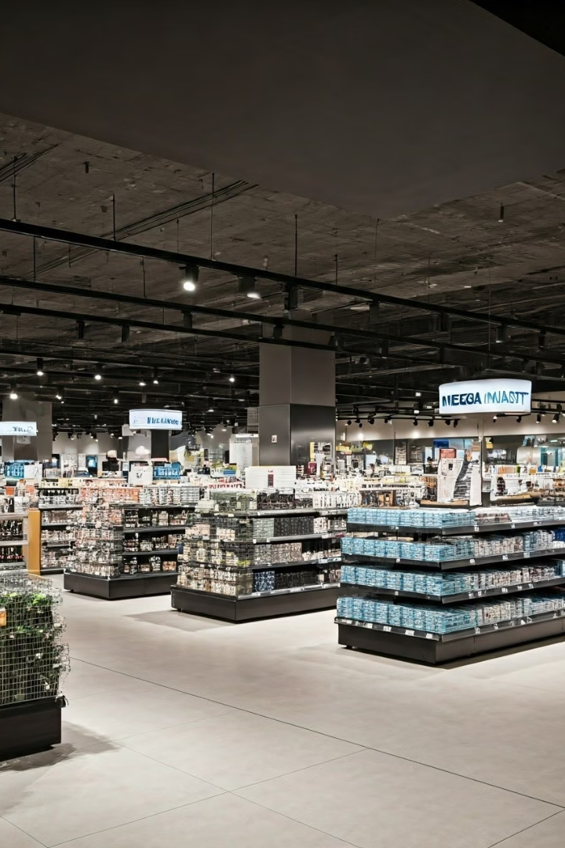
MEGA MART STRATEGIC DATA INSIGHTS
This presentation analyzes key data insights from MEGA MART's TP-CDS database, providing recommendations for strategic improvement.

Slide 2


Key Strengths of Mega Mart
1
Diverse Product Range
Offers a wide variety of products to cater to diverse customer needs.
2
Strong Online Presence
Provides a convenient and accessible online shopping experience.
3
Customer-Centric Approach
Prioritizes customer satisfaction through personalized service and competitive pricing.
4
Efficient Supply Chain
Ensures timely delivery and availability of products.

Slide 3

Competitive Advantage
MEGA MART's strong foundation, diverse product range, and customer-focused approach position it as a formidable competitor in the retail industry. The company's ability to adapt to changing consumer trends and leverage technology sets it apart from its peers.

Slide 4
Sales Performance
Regional Variations
Customer Service
The map shows that sales are concentrated in certain regions, with states like GA, TX, IN, and CA having higher sales volumes.
Improve order fulfillment processes to ensure timely delivery and reduce customer complaints.
Invest in training and support for customer service teams to provide exceptional service and address customer concerns promptly.

Slide 5

Inventory Management
Inventory Turnover Ratio
Stockout Rate
Recommendations
Suggests that 5.09% of customer orders cannot be fulfilled due to lack of inventory.
Improve demand forecasting techniques to better predict product needs and avoid stockouts.
Indicates the company sells and replaces its inventory approximately 48 times a year.

Slide 6
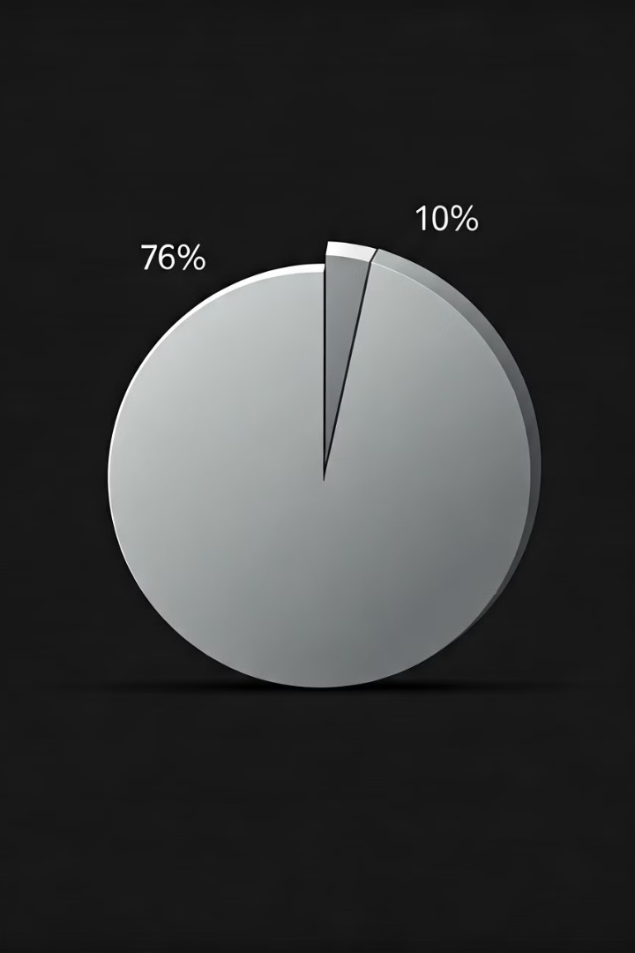
Customer Behaviour
99K customers have made repeat purchases, indicating a strong customer loyalty base. 98.99% of customers have made repeat purchases, highlighting the company's ability to retain customers.
Implement personalized marketing campaigns to target repeat customers and encourage further purchases. Consider introducing a loyalty program to reward repeat customers and incentivize additional purchases.

Slide 7





Overall Review
Customer Segmentation
There appears to be a need for more granular customer segmentation to tailor marketing and sales efforts effectively.
Inventory Optimization
While the overall inventory turnover ratio is good, there are specific categories and regions that may require further optimization.
Channel Synergy
There may be opportunities to improve synergy between different sales channels, such as online and in-store, to enhance customer experience and increase sales.
Promotional Effectiveness
While promotions have been effective in driving sales, there is room for improvement in targeting and personalization.
Supply Chain Resilience
The company should assess its supply chain's resilience to disruptions, such as natural disasters or economic downturns.

